Slide 1
SSL/TLS

Slide 2
Layers of Security
 |  |  |  | HTTP | FTP | SMTP |  |  | S/MIME | PGP | SET
HTTP | FTP | SMTP |  | SSL or TLS |  |  |  | Kerberos | SMTP |  | HTTP
TCP |  |  |  | TCP |  |  |  | UDP | TCP
IP/IPSec |  |  |  | IP |  |  |  | IP
(a) Network Level |  |  |  | (b) Transport Level |  |  |  | (c) Application Level

Slide 3
SSL History
Evolved
Unreleased v1 (Netscape)
Defined
RFC6101, https://www.rfc-editor.org/rfc/rfc6101
Implement
Open-source implementation at http://www.openssl.org/
Flawed-but-useful v2
Version 3 from scratch
Standard TLS1.0 (SSL3.0 with minor tweaks, hence Version field is 3.1)

Slide 4
Overview
Establish a session
- Agree on algorithms
Transfer application data
Ensure privacy and integrity
- Share secrets
- Perform authentication

Slide 5
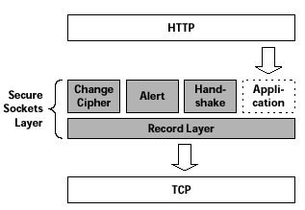
Architecture
Record Protocol to transfer application and TLS information
A session is established using a Handshake Protocol
INITIALIZES SECURE
COMMUNICATION
ERROR HANDLING
HANDLES COMMUNICATION
WITH THE APPLICATION
Protocols
INITIALIZES COMMUNCATION
BETWEEN CLIENT & SERVER
HANDLES DATA
COMPRESSION

Slide 6
Handshake
Negotiate Cipher-Suite Algorithms
Establish and share master secret
Optionally authenticate server and/or client
Symmetric cipher to use
Key exchange method
Message digest function
Notes:
Encryption mac key exchange
Des/3des/des40 md5, sha1, none rsa, dh
rc2 rc4
idea
none

Slide 7
Handshake Phases
Handshake Phases
Hello messages
Certificate and Key Exchange messages
Change CipherSpec and Finished messages

Slide 8
SSL Messages
CLIENT SIDE
Offer cipher suite menu to server
Send enc sym key
Activate enc
Client portion done
(Client checks options)
SERVER SIDE
Select a cipher suite
Send cert and chain to CA root
Send pub key to enc sym key
Server negotiation finished
(Server checks options)
ActivateServer enc
Server portion done
1. ClientHello
2. ServerHello
3. Certificate
4. ServerKeyExchange
5. ServerHelloDone
6. ClientKeyExchange
7. ChangeCipherSpec
8. Finished
9. ChangeCipherSpec
10. Finished
Now the parties can use symmetric encryption
Thomas, S. (2000). SSL and TLS Essentials: Securing the Web.
Notes:
52

Slide 9
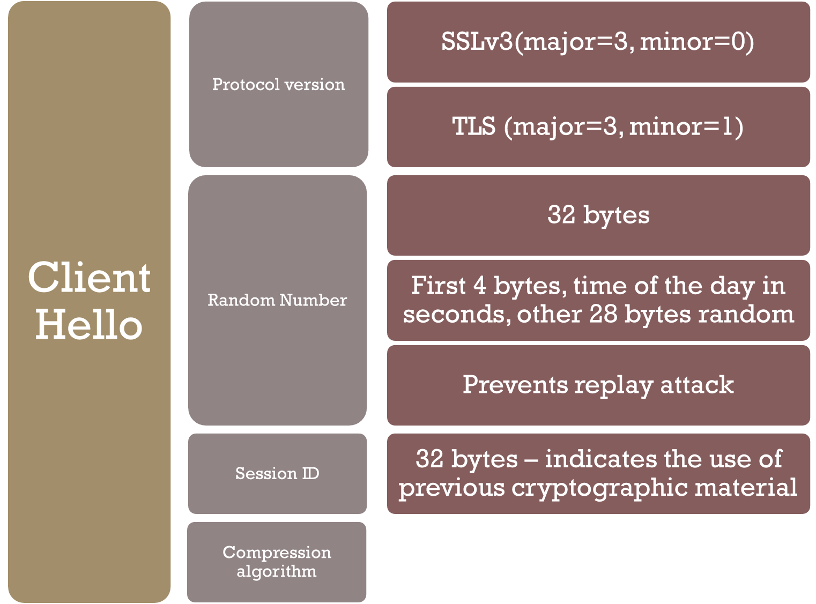
Client Hello
Notes:
Server “Hello Request”- ask client to restart
hello includes some random data for creating the master secret

Slide 10
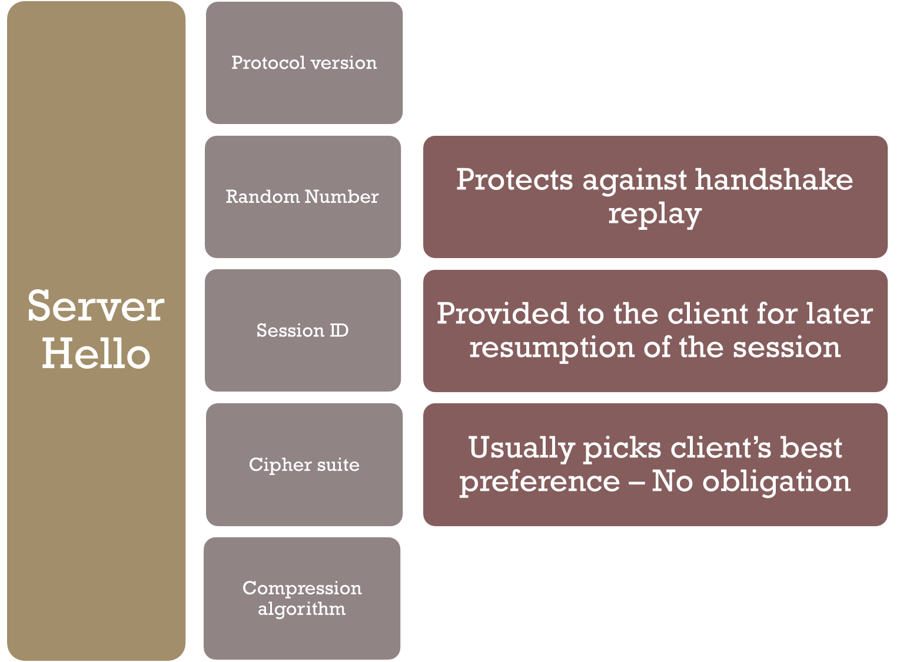
Server Hello

Slide 11
CERTIFICATES
Client Key Exchange
Premaster secret
Change Cipher Spec
Finished
Sequence of X.509 certificates
X.509 Certificate associates public key with identity
CA creates and sign cert according to policies
User of Certificate must ensure it is valid
Created by client
2 bytes of SSL version + 46 random bytes
Sent encrypted to server using server’s public key
Switch to newly negotiated algorithms and key material
First message encrypted with new crypto parameters
Digest of negotiated master secret, the ensemble of handshake messages, sender constant
HMAC approach of nested hashing

Slide 12
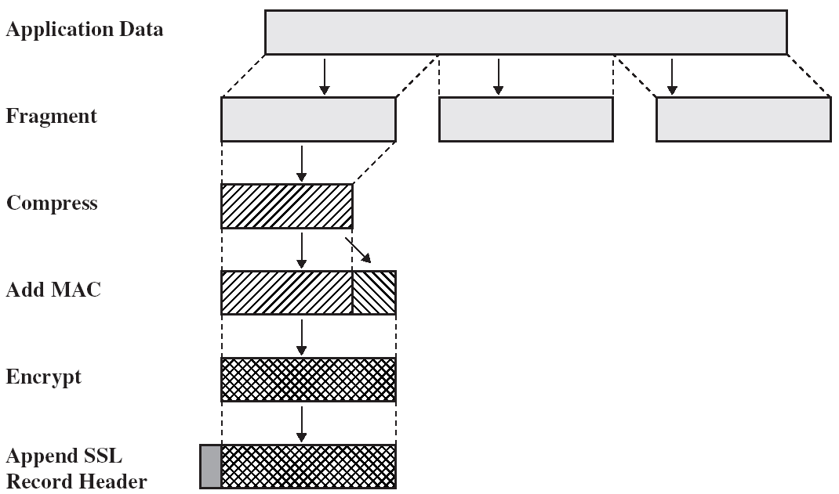
SSL Record Protocol
Notes:
52

Slide 13
Record Header
Content type
Application data
Alert
Handshake
Change_cipher_spec
Content length
Suggests when to start processing
SSL version
Redundant check for version agreement

Slide 14
MAC (message authentication code)
Max. record length 2^{14 –} 1
Alerts and Closure
Alert the other side of exceptions
MAC
Data
Headers
Sequence number
To prevent replay and reordering attack
Not included in the record
Different levels
Terminate and session cannot be resumed
Closure notify
To prevent truncation attack (sending a TCP FIN before the sender is finished)

Slide 15
Thank you

